Slide 1
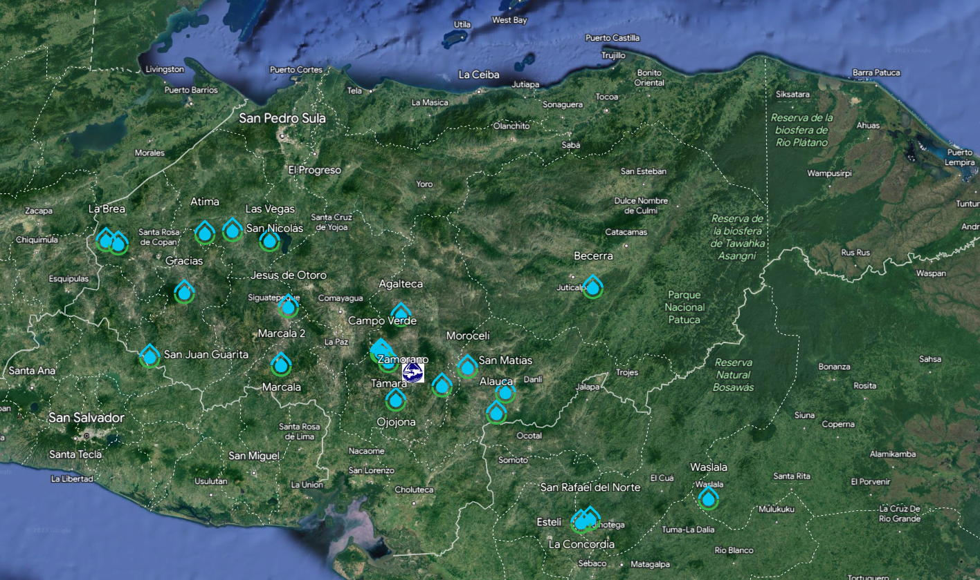

Slide 2
San Francisco de Becerra, Olancho, Honduras
6000 people
36 L/s (should have reserve capacity – this is 6 mL/s per person)
Construction currently underway
Will be a blend of our 2017 designs with a few new features
25th AguaClara plant in Central America
There will be over 100,000 people receiving water from AguaClara plants when Becerra is completed!

Slide 3
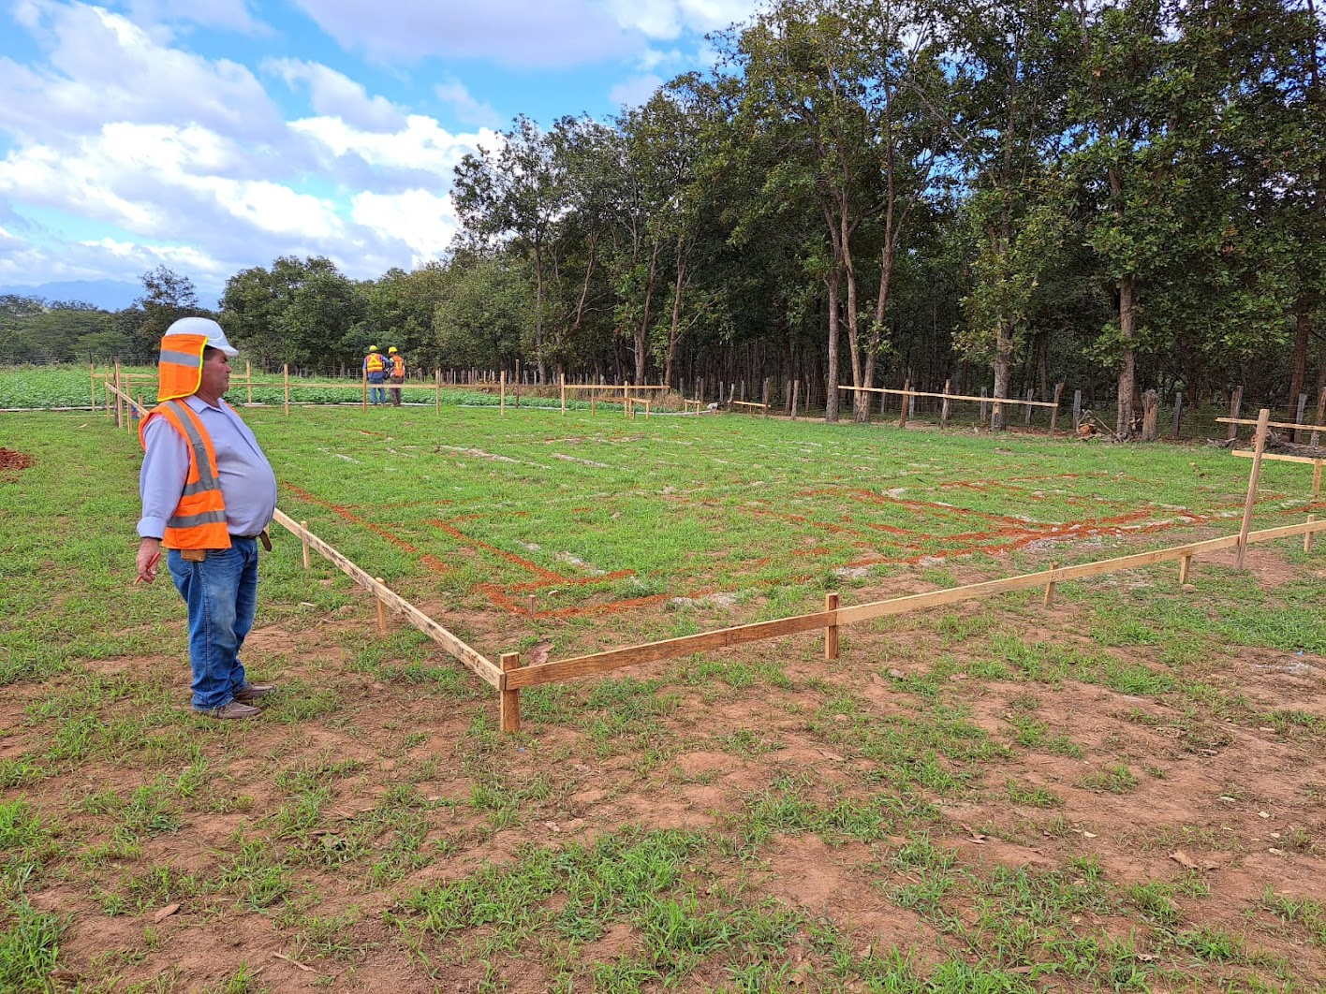
This isn’t an empty field anymore!
Lines are drawn to define where to start digging
German has supervised the construction of more AguaClara Plants than anyone else!
Notes:
See the

Slide 4
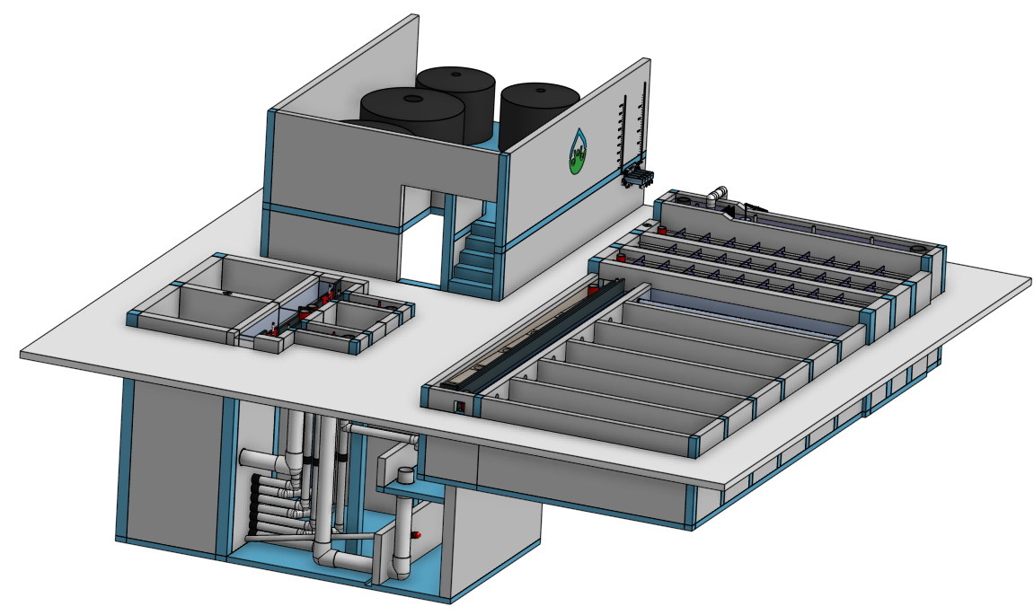

Slide 5
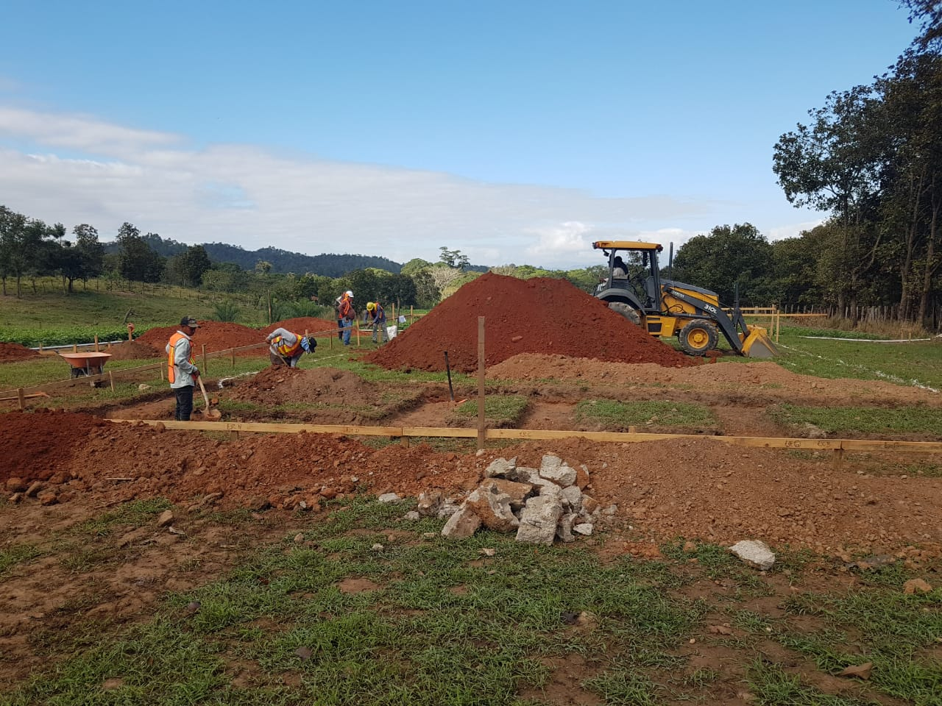

Slide 6
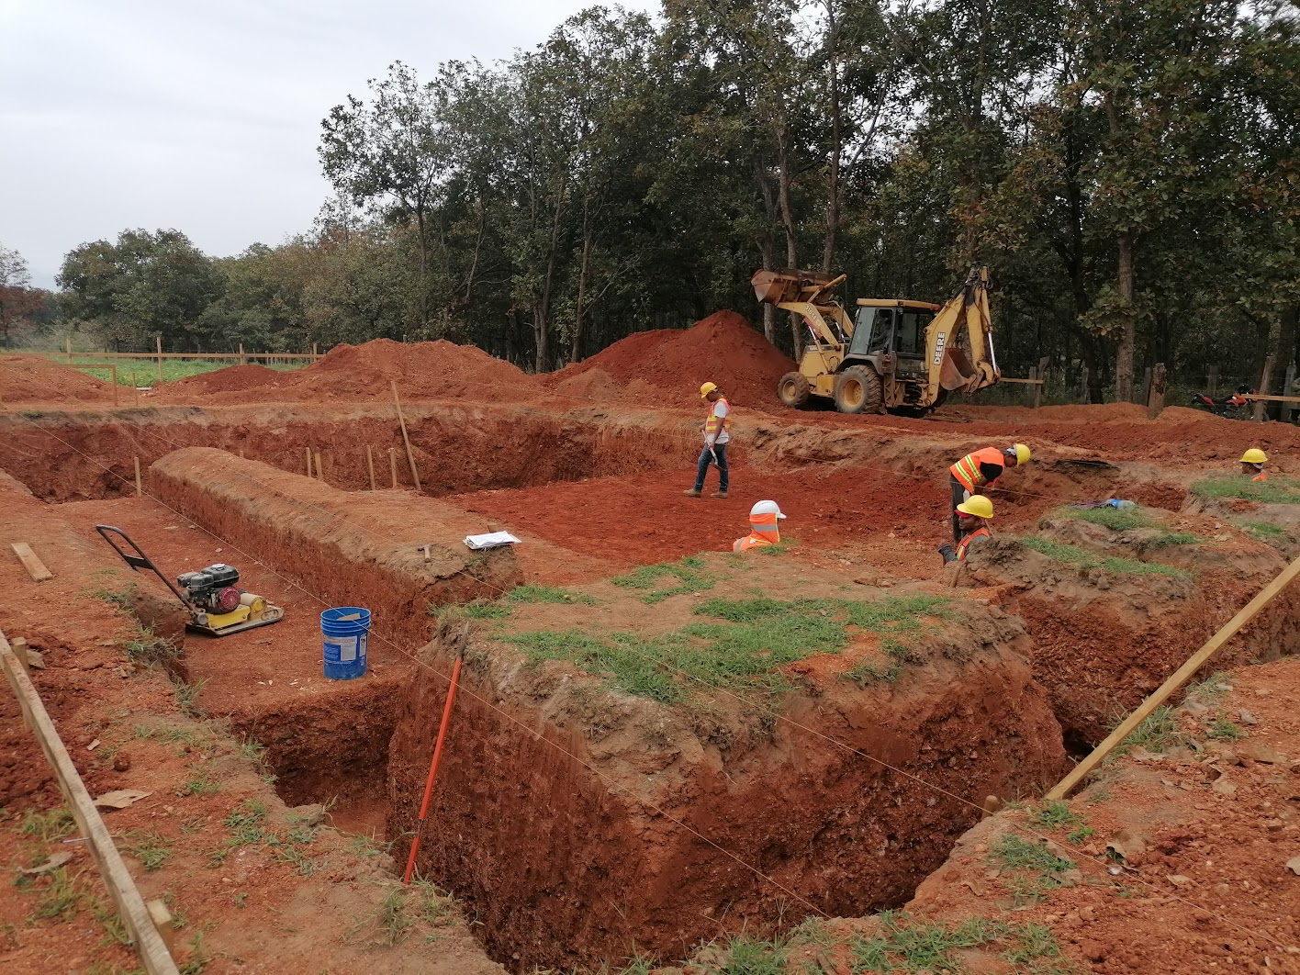
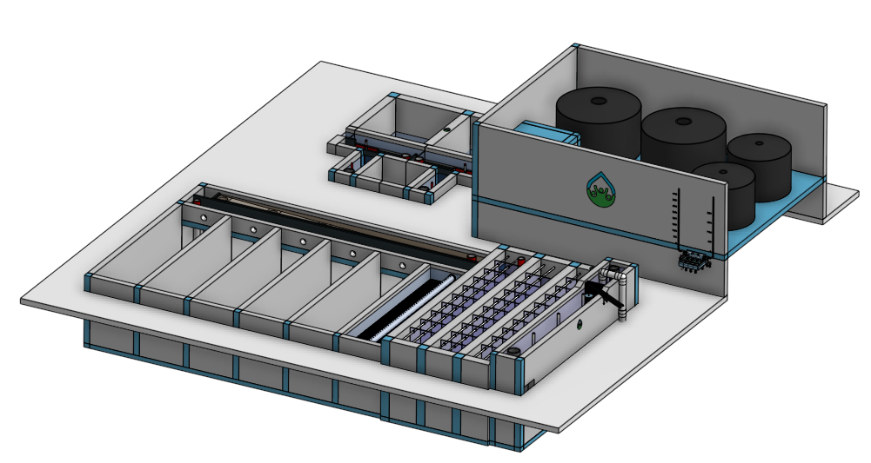
Filters
Clarifier
Floc
Entrance Tank

Slide 7
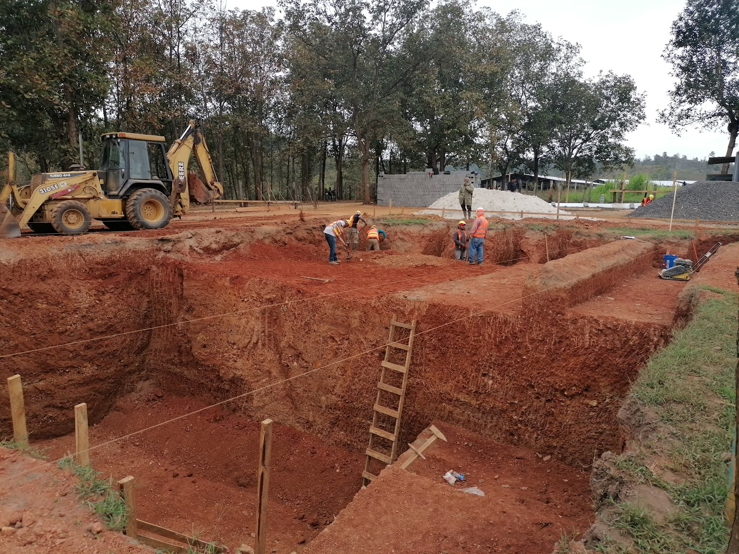

Slide 8
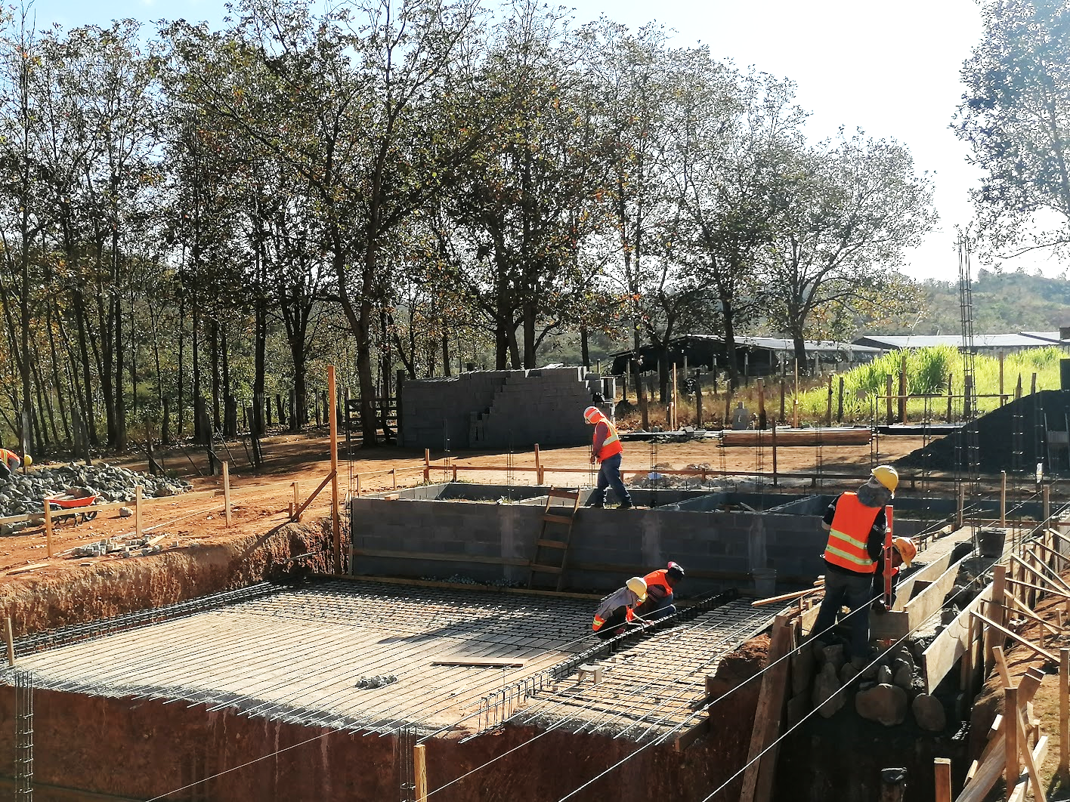
Laboratory
Sleeping room
Bathroom
?
Entrance Tank
Clarifier
Floc

Slide 9
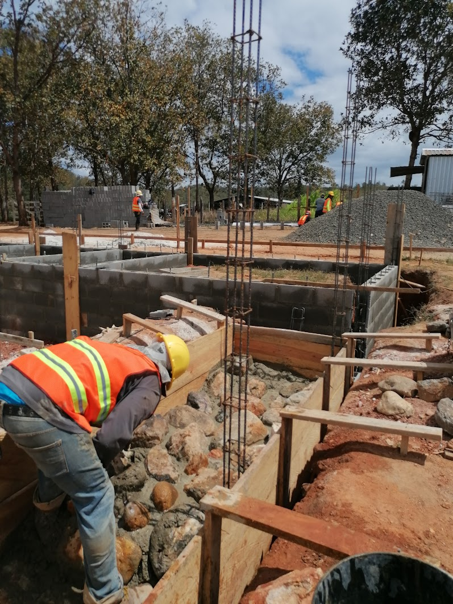
Entrance Tank Foundation

Slide 10
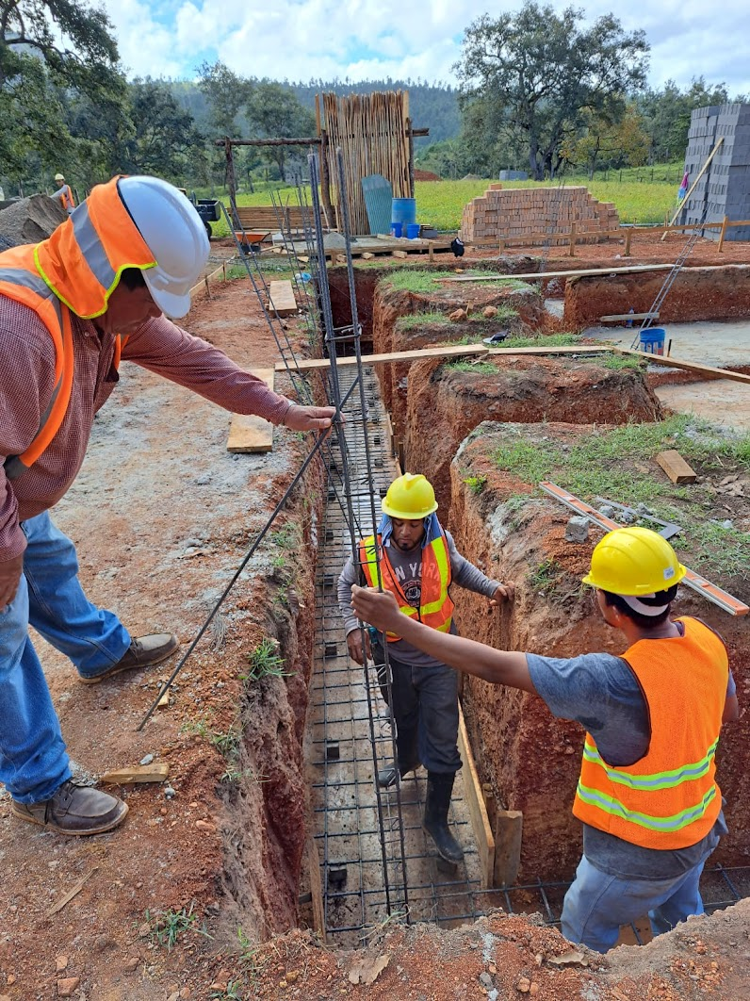
Building exterior wall foundation

Slide 11
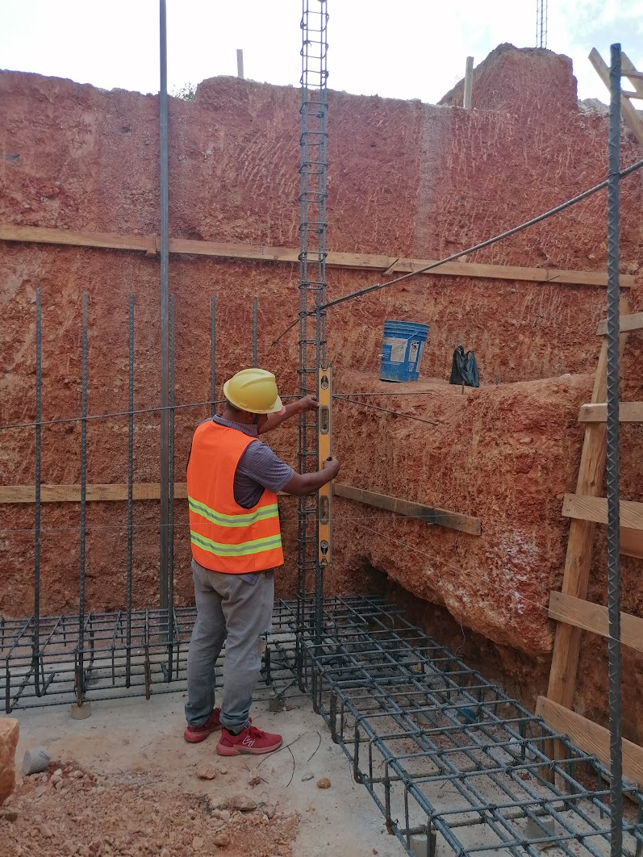
Filter foundation

Slide 12
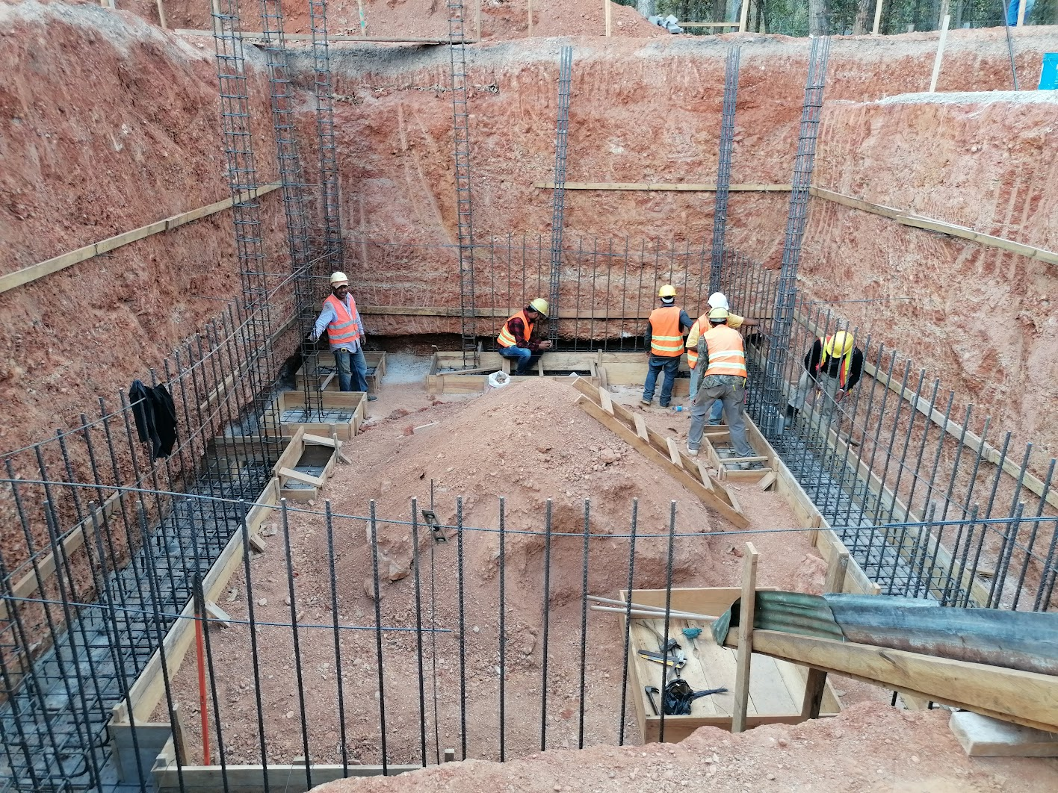
Filter and Pipe Gallery

Slide 13
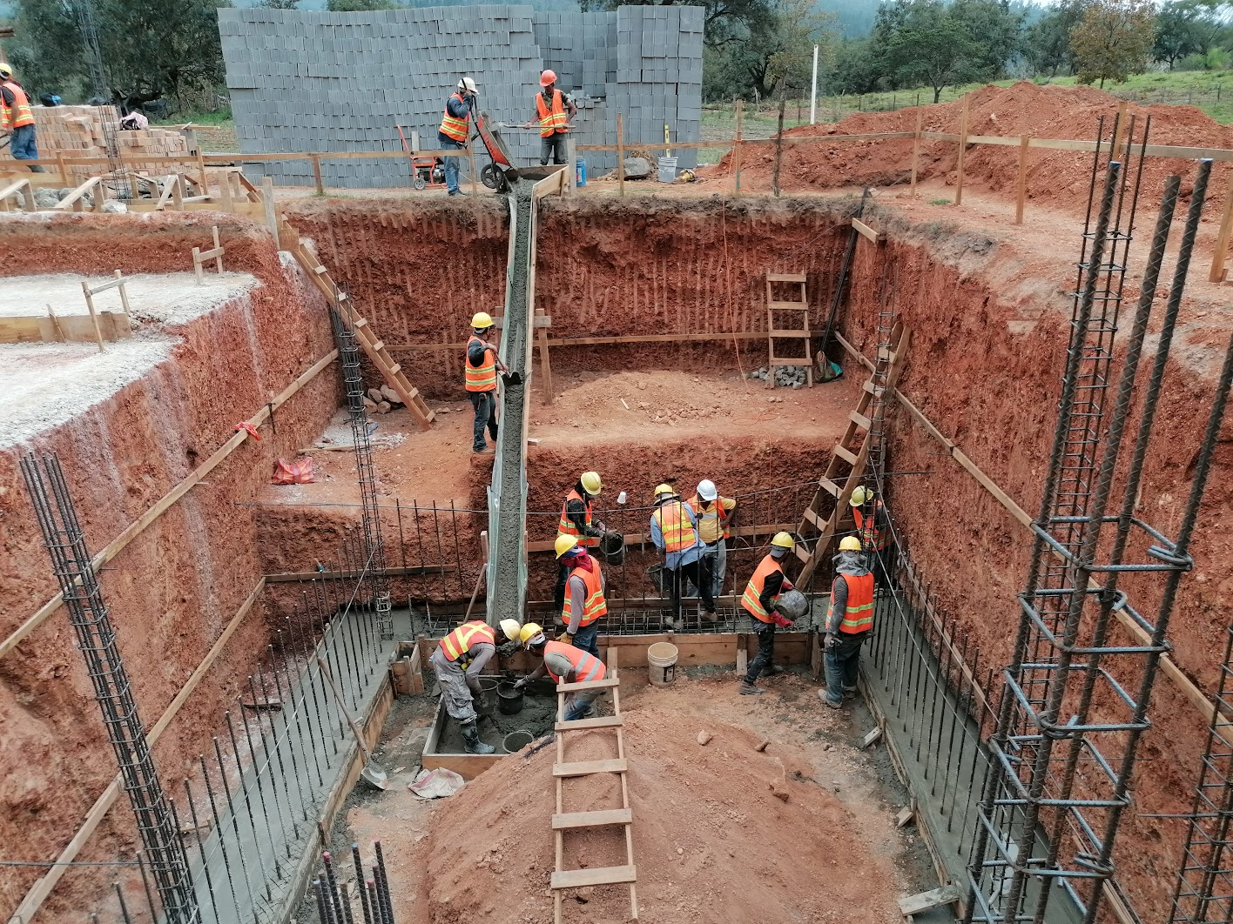

Slide 14
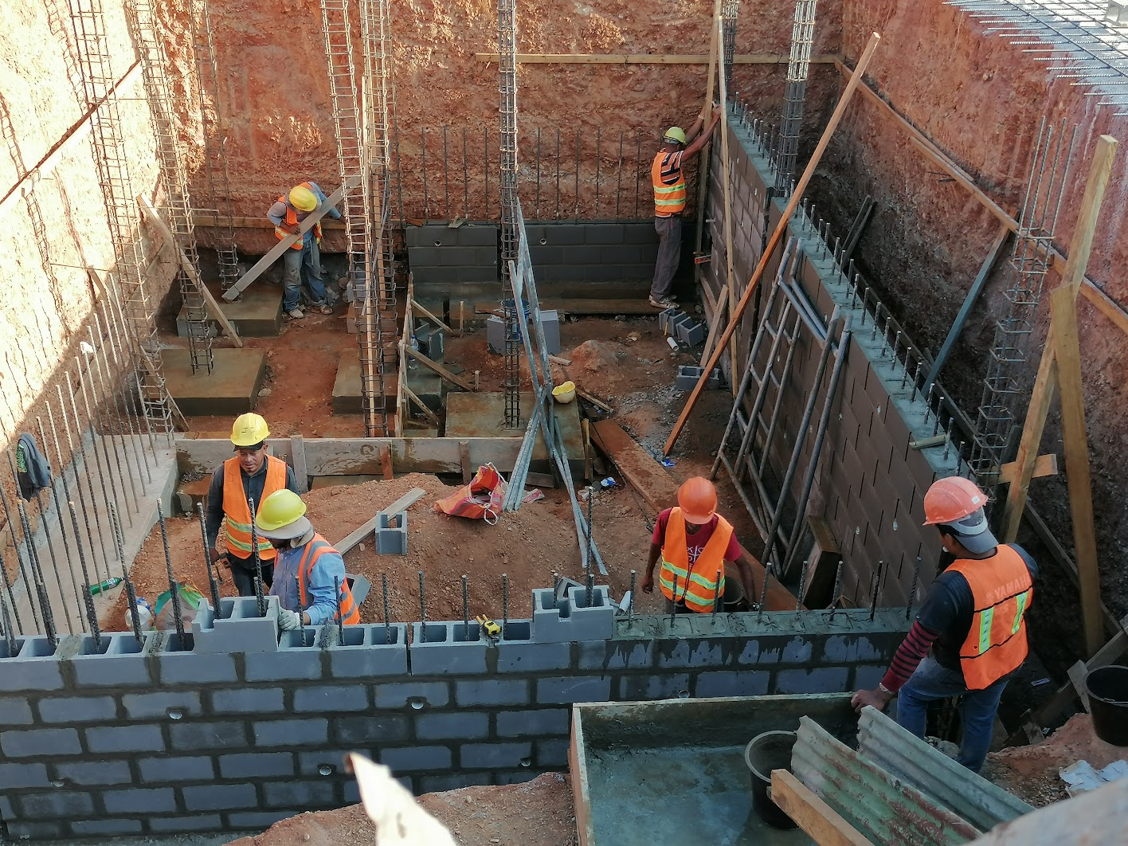
6 corners for two filters
Drain Channel

Slide 15
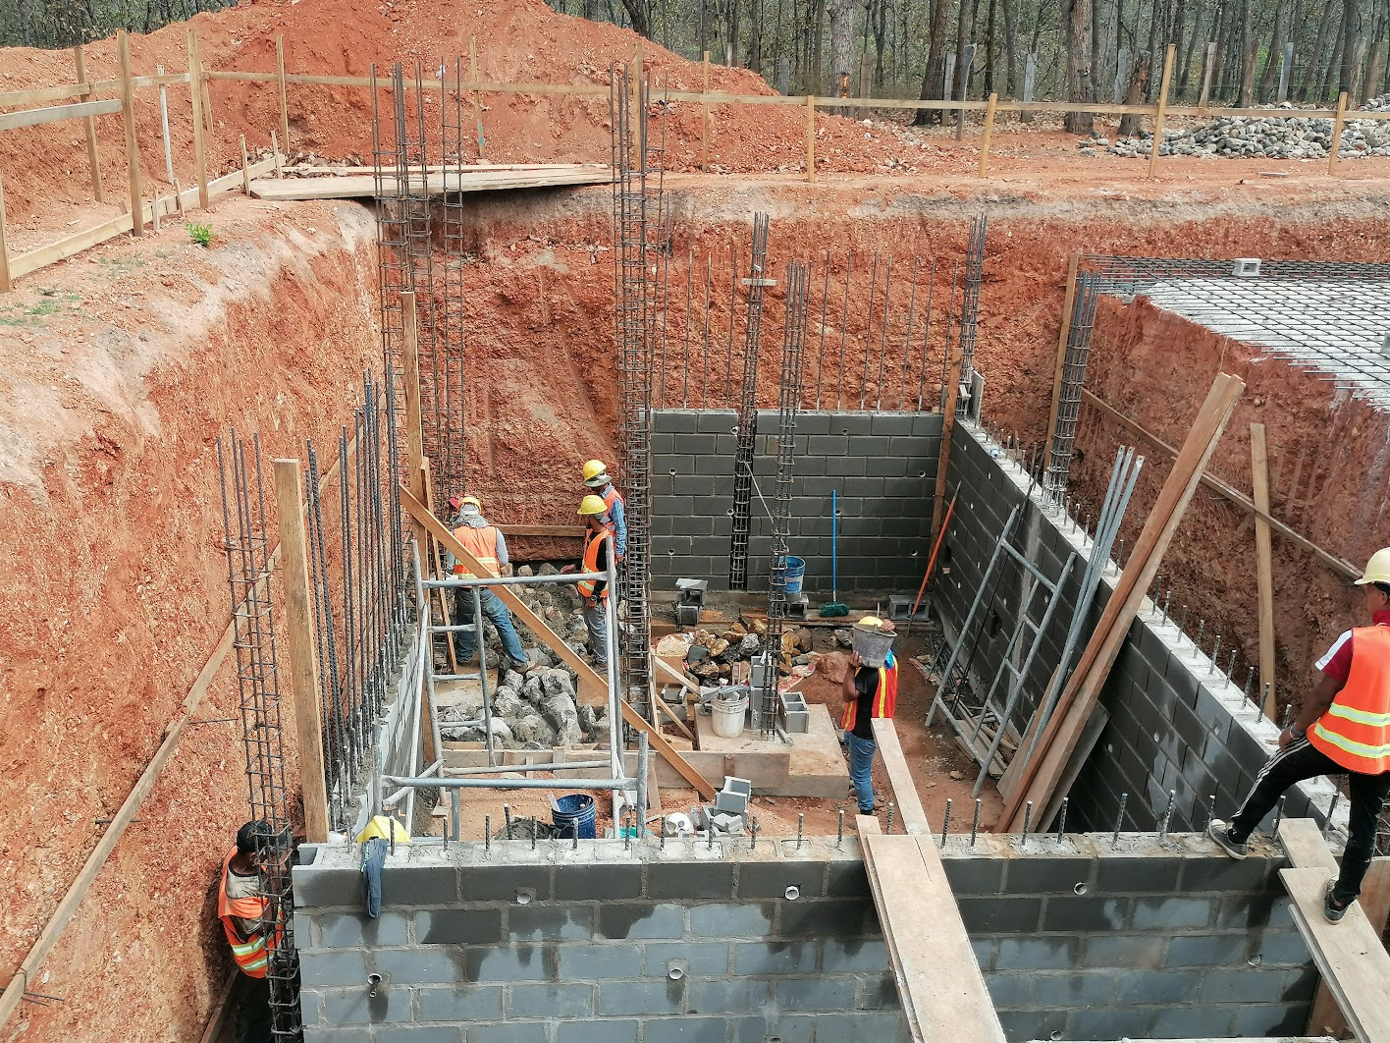
Filter Foundations

Slide 16
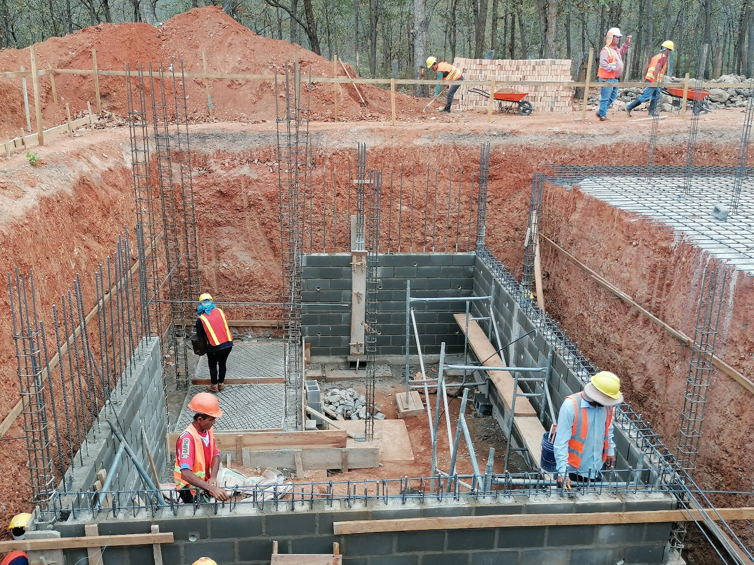
Filter Foundations

Slide 17
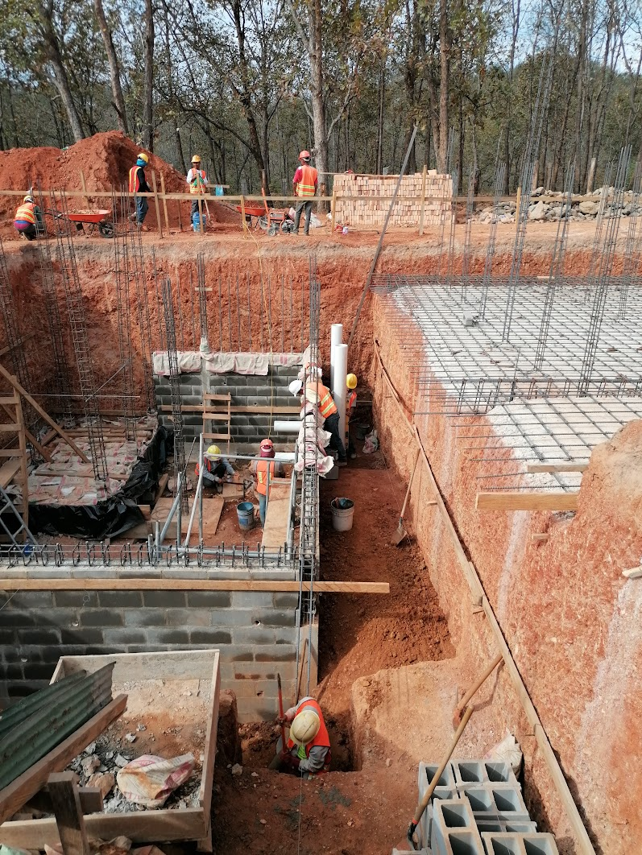
Respect! Planning!
Filter backwash drain pipes

Slide 18
Materials you can purchase from local suppliers
Bricks
Concrete blocks
Gravel
Rebar

Slide 19
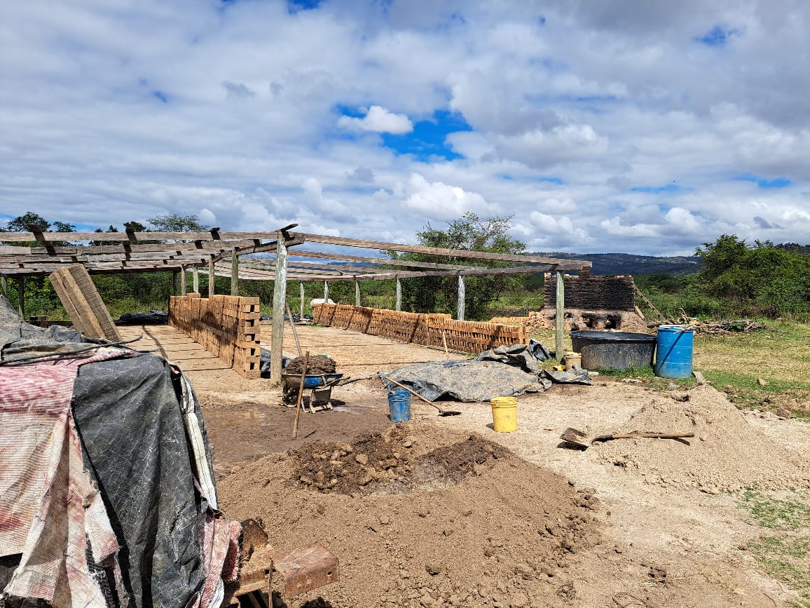
Bricks

Slide 20
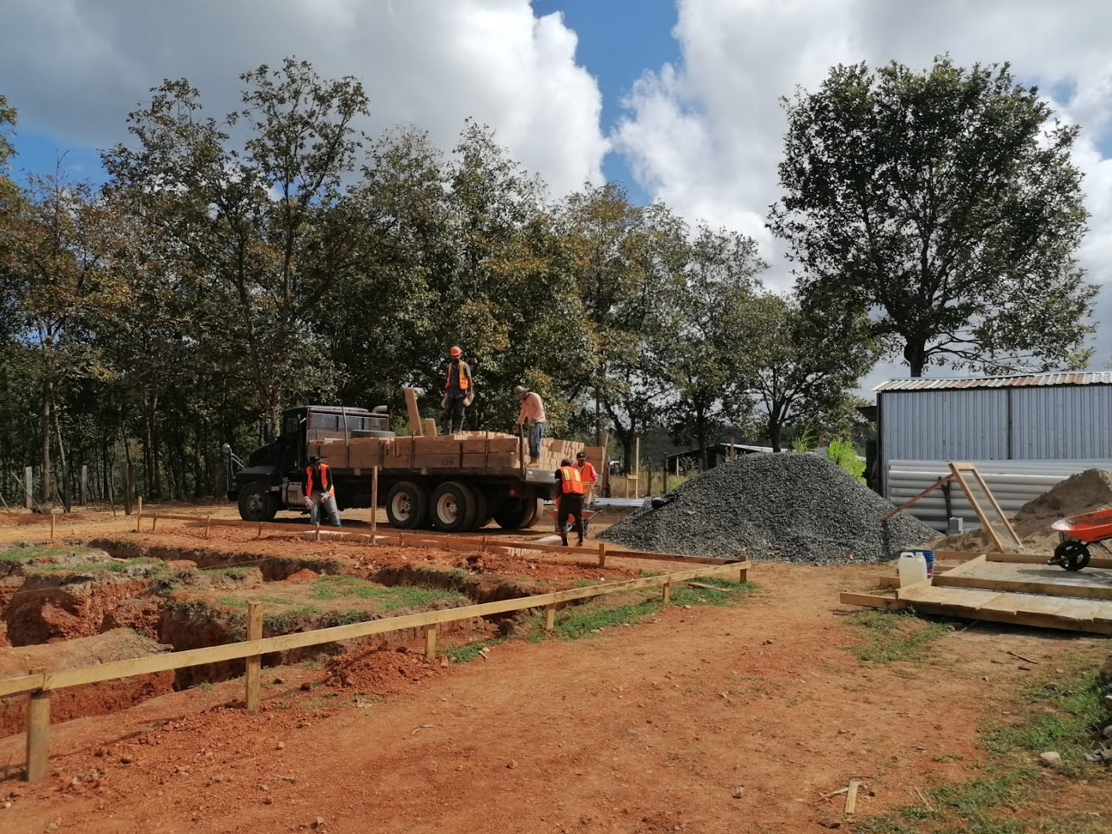

Slide 21
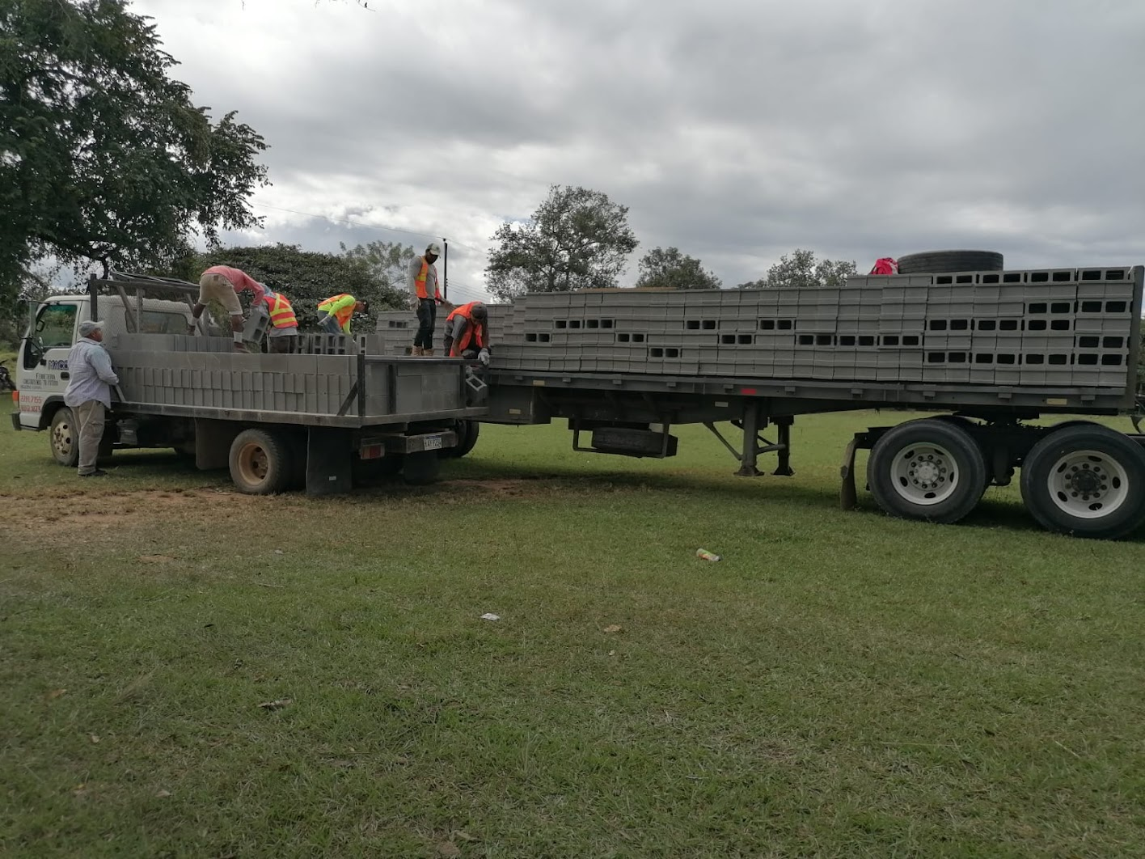

Slide 22
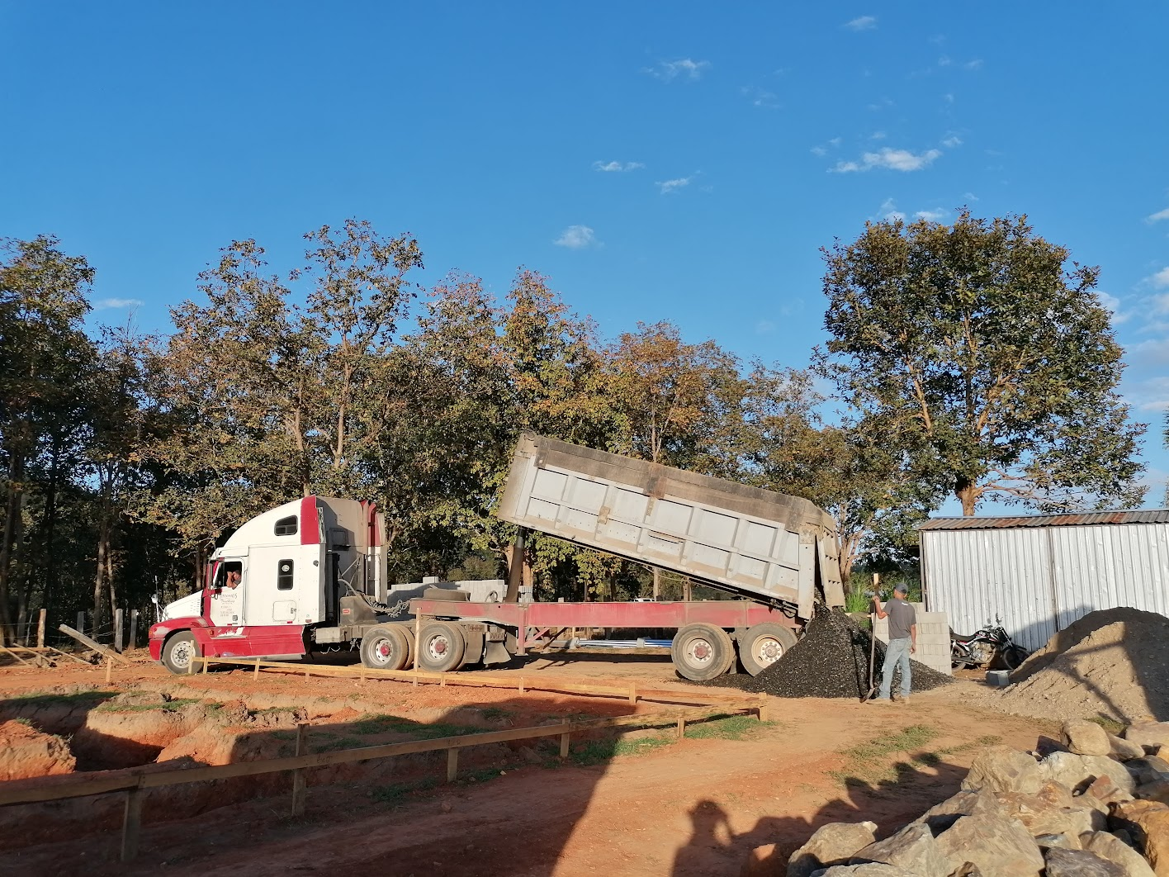

Slide 23
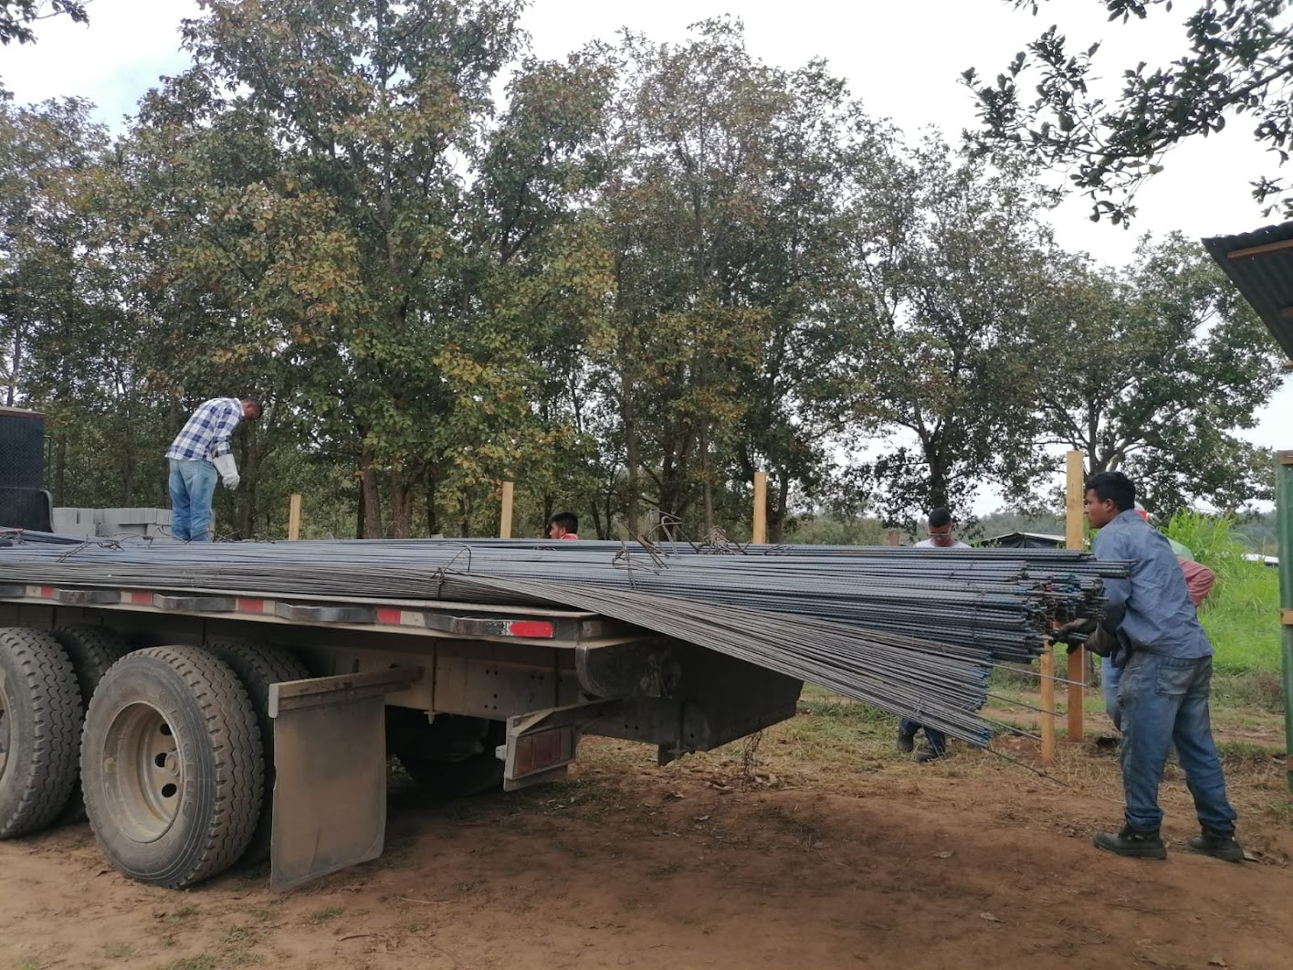

Slide 24
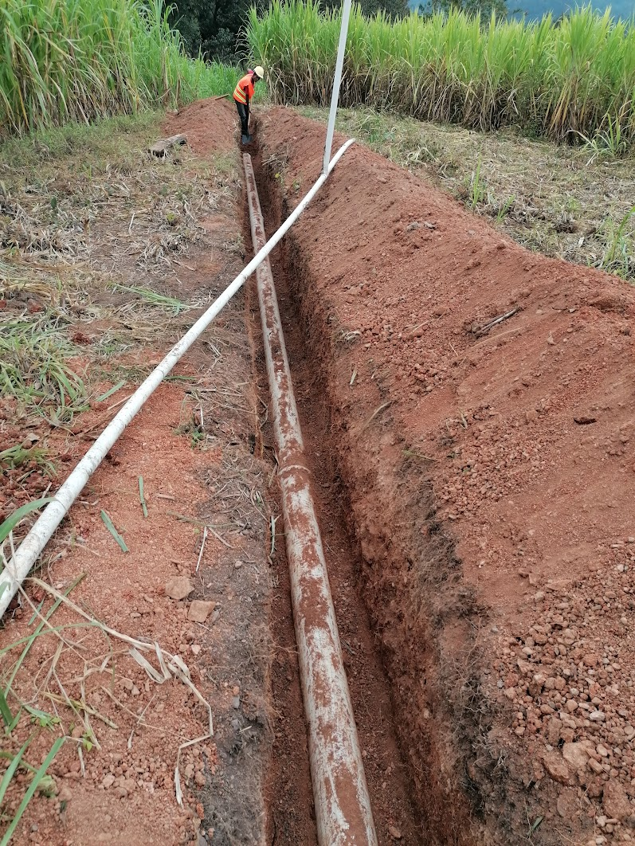
Source water transmission line
Uncovering the water pipe to eventually make the connection to the plant

Slide 25
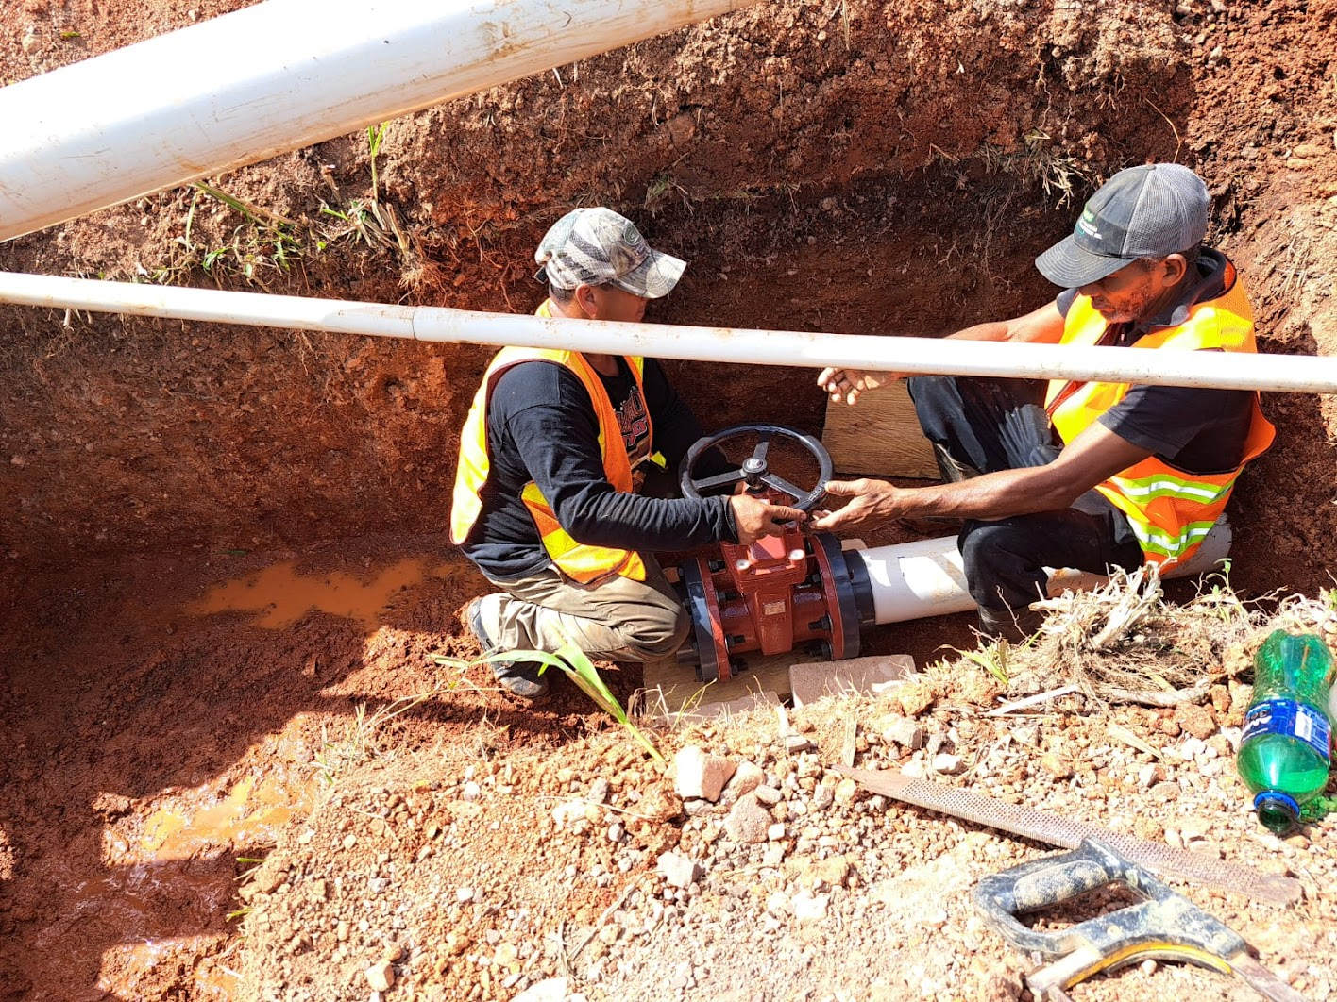

Slide 26
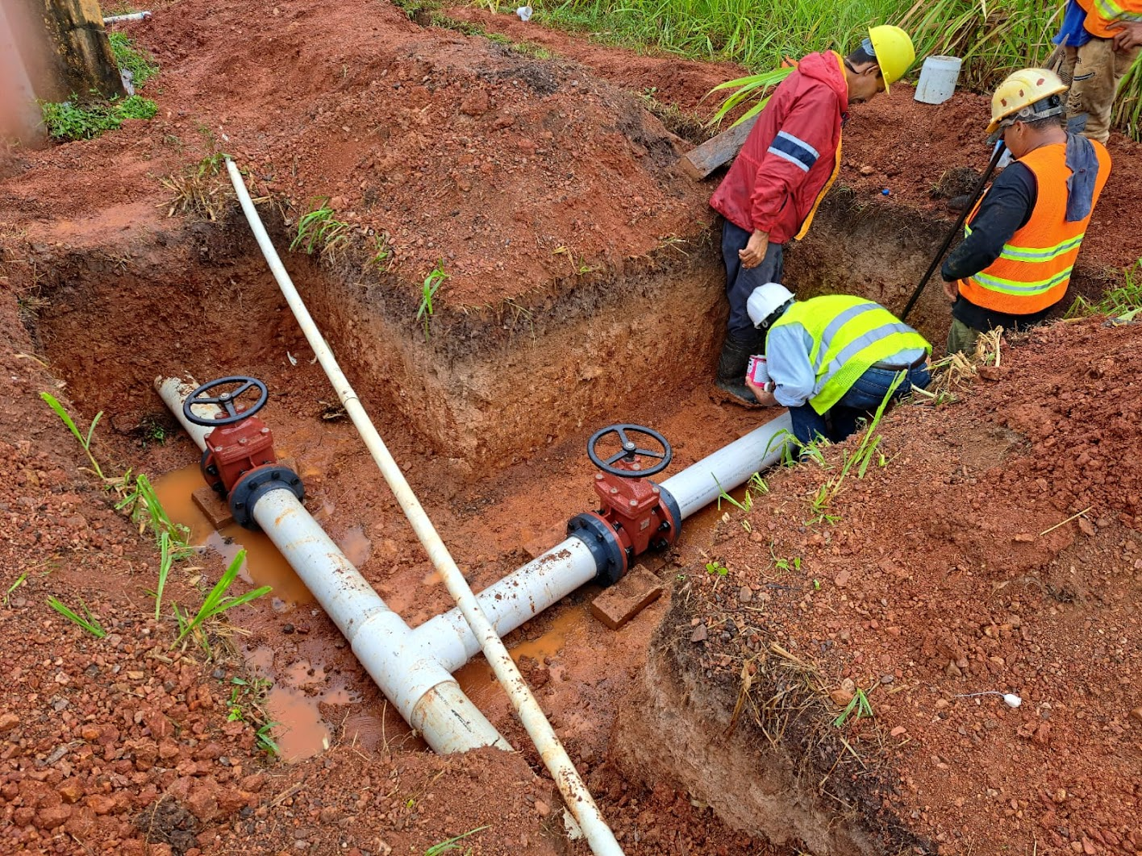

Slide 27
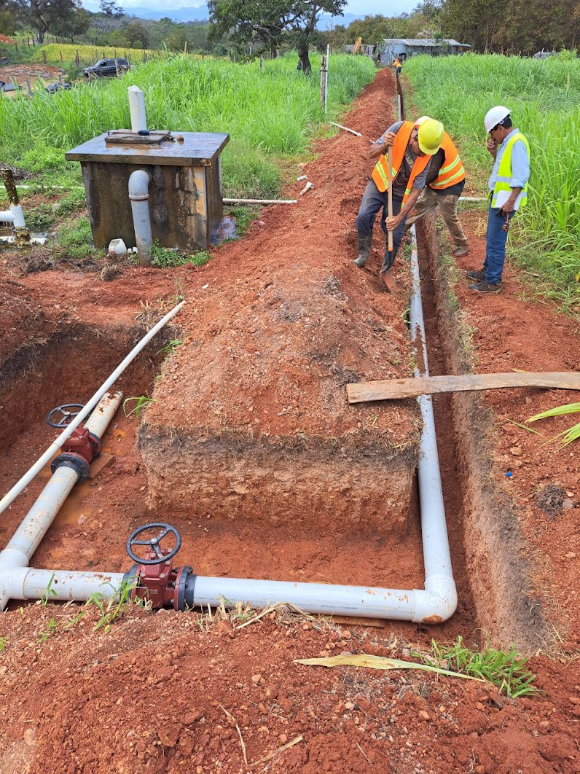
Tie in to transmission line
To AguaClara plant
Bypass to Becerra

Slide 28
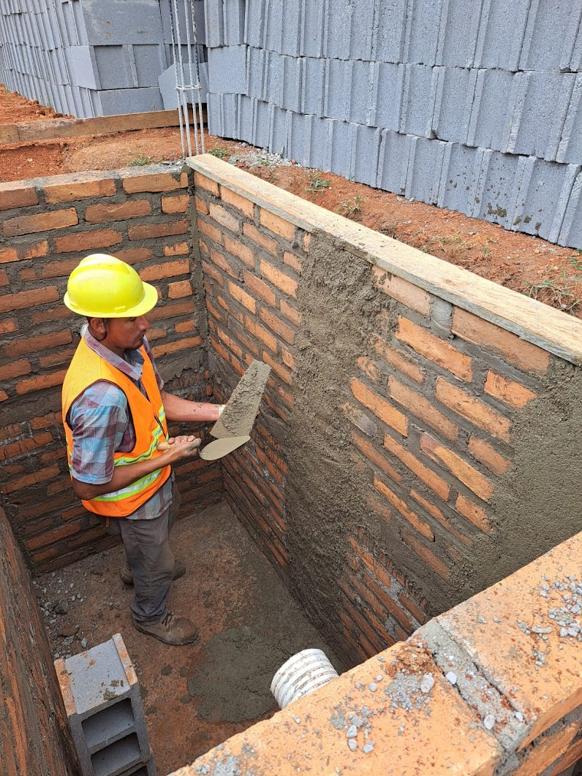
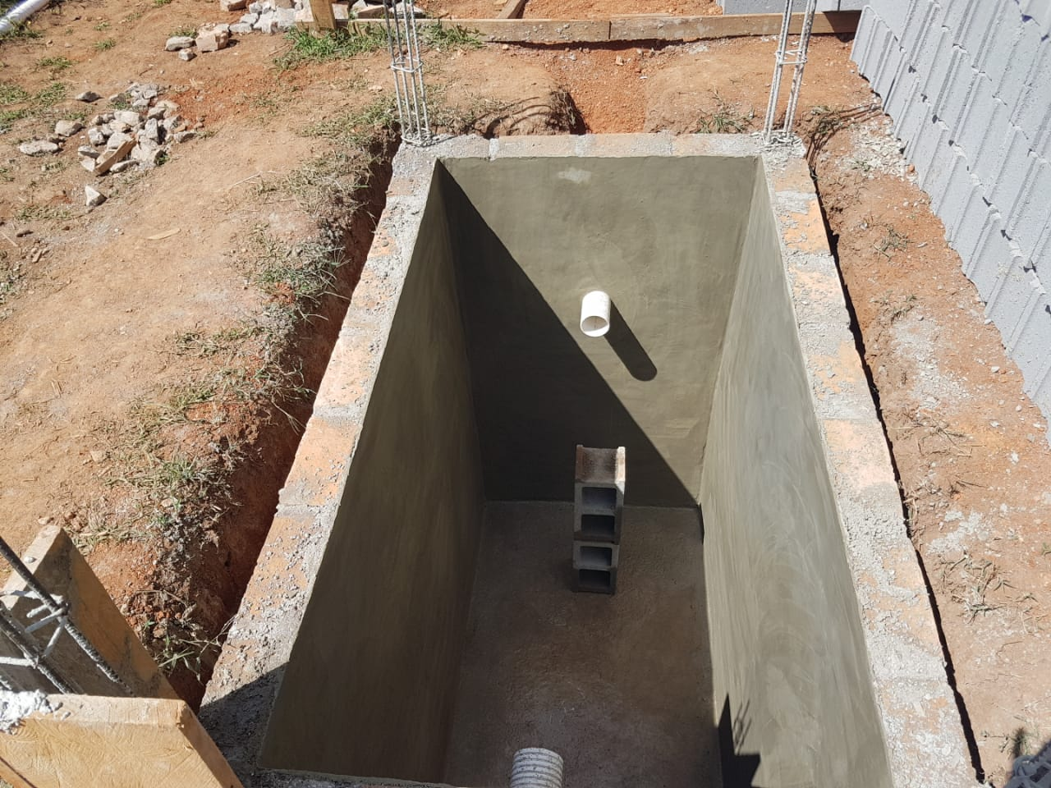
Septic Tank

Slide 29
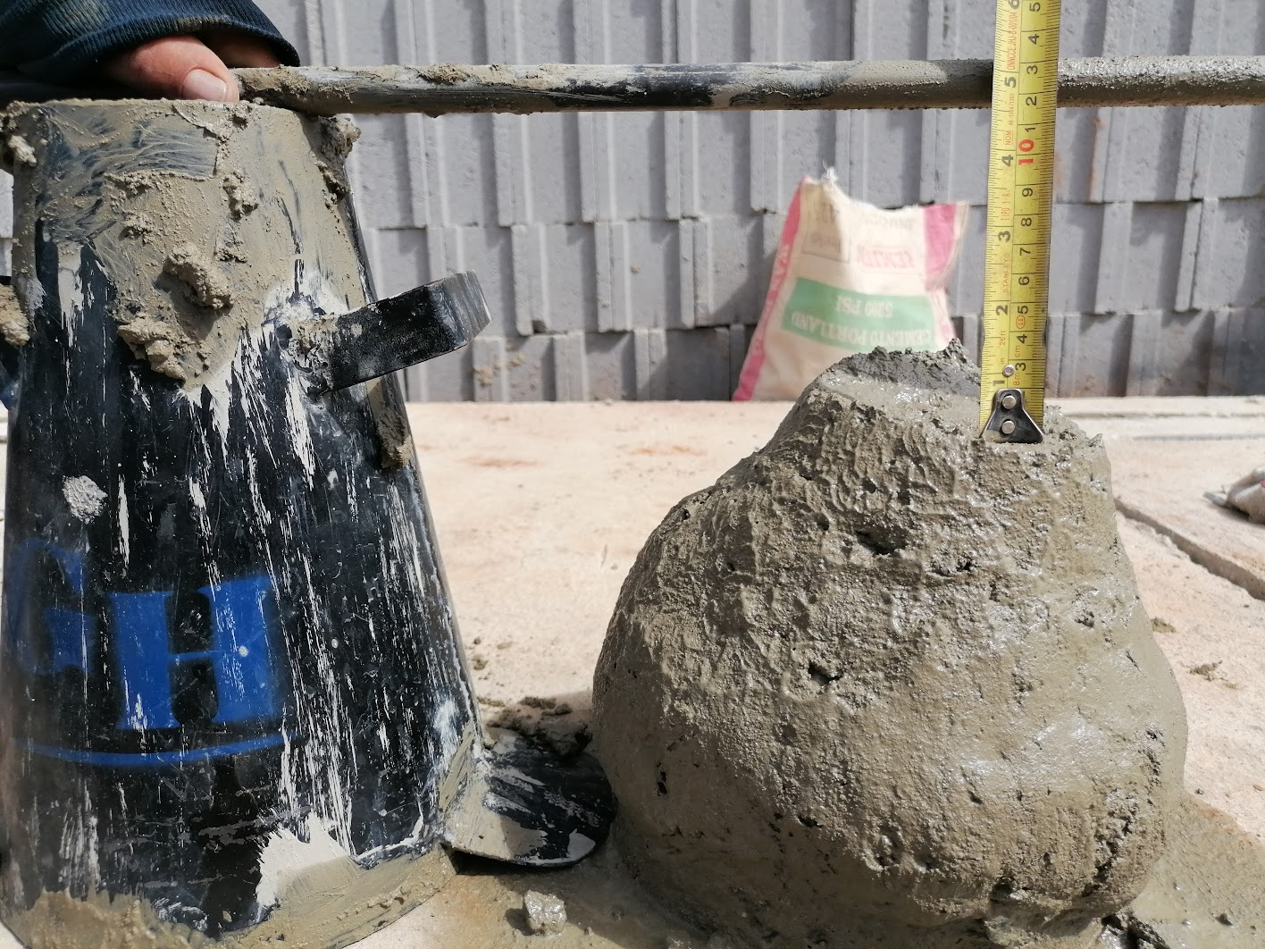
Slump test

Slide 30
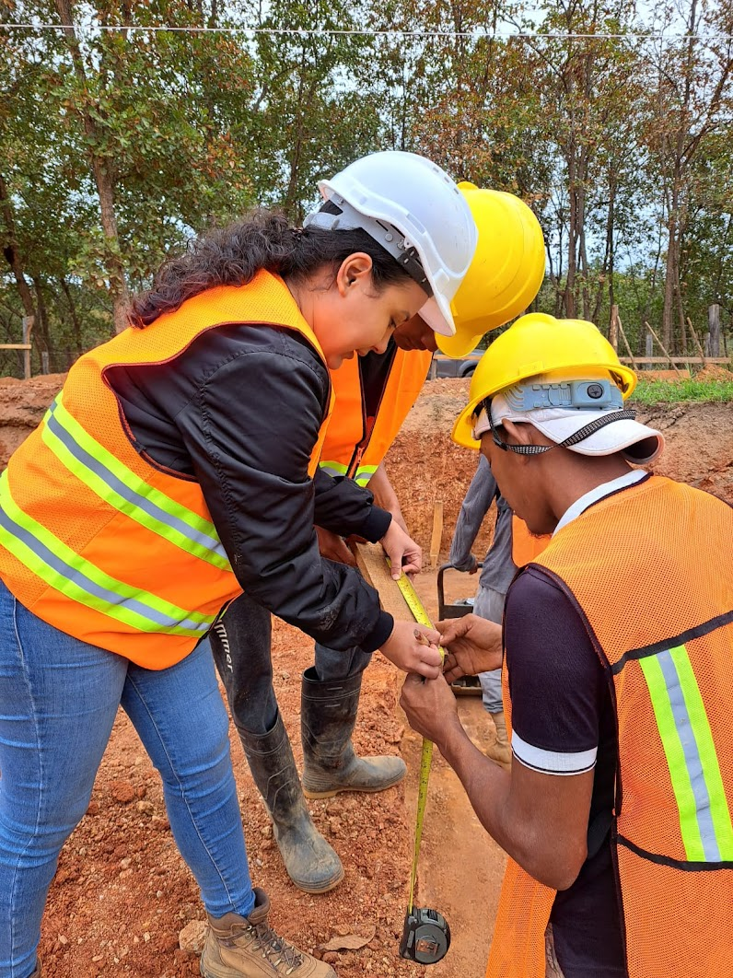
Site Engineer: Yellin Benitez Nuñez

